Slide 1

National Institute of Technology Karnataka Surathkal Department of Information Technology
IT 252 DATABASE SYSTEMS
Database Recovery Techniques
Dr. Jayashree T R

Slide 2
Course Outline
Course Plan: Theory:
Part A: Parallel Computer Architectures
Week 1: Introduction to to the course, highlighting the data and databases, and related basic concepts. Advantages and need for a database system.
Week 2: Attributes, tuples, relational schema, conceptual model, introduction to SQL-DML, DDL, creating relations/ tables, access and manipulate data.
Week 3,4: Data model, relational model, and SQL, relational data model and relational database constraints, SQL data definition and data types, specifying constraints, basic retrieval queries, complex quires, triggers, views, schema modification.
Week 5-6: ER model development, entity types/sets, attribute, relationship types/sets, simple employee database conceptual design using ER concepts, ER to relational mapping algorithm, EER model.

Slide 3
Course Outline
Functional dependency definition, need of normalization, anomalies and redundant information in tuples, normalization steps (INF, 2NF, 3NF), BCNF, introduction to the higher normal forms.
W
eek 7,8 :
Week 9: Procedural query languages: relational algebra and SQL-SELECT, PROJECT, RENAME, binary and JOIN operations with examples.
Non-Procedural query languages: relational calculus, and SQL-tuple relational calculus, existential a universal quantifier with examples.
Week 10,11 : Transaction management, schedule and serializability, concurrency control, 2-phase lock, recovery mechanism: undo/redo values.
Week 12,13: Disk storage- basic file structures, ordered/unordered. binary search, hashing, indexing, importance of indexes, primary and secondary indexing methods, clustered, B tree, B++ trees.
Week 14: Current trends in database system, introduction to data warehousing, data mining.
Practical: MySQL commands
Project: Team of 2 or 3 members

Slide 4
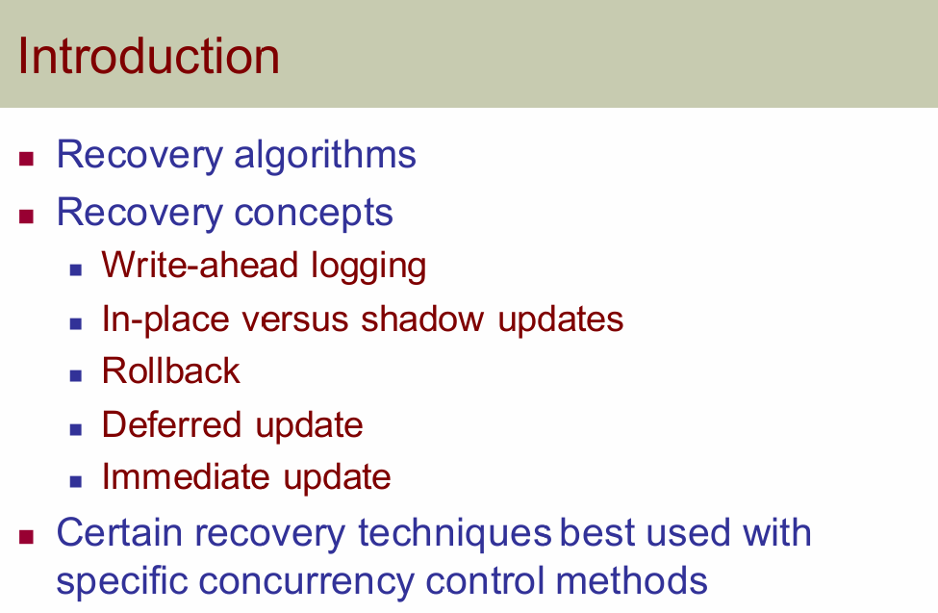

Slide 5
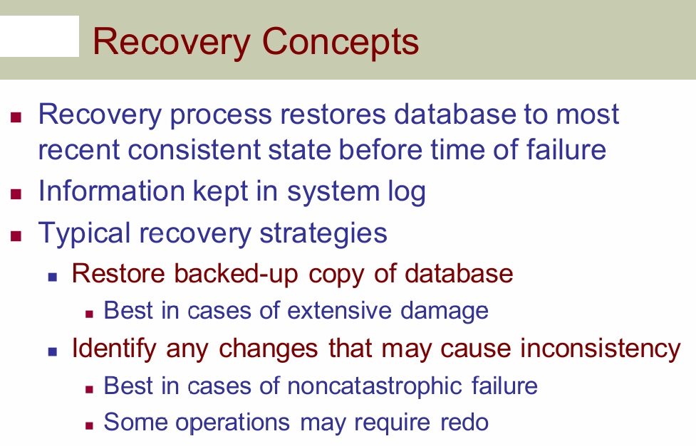

Slide 6
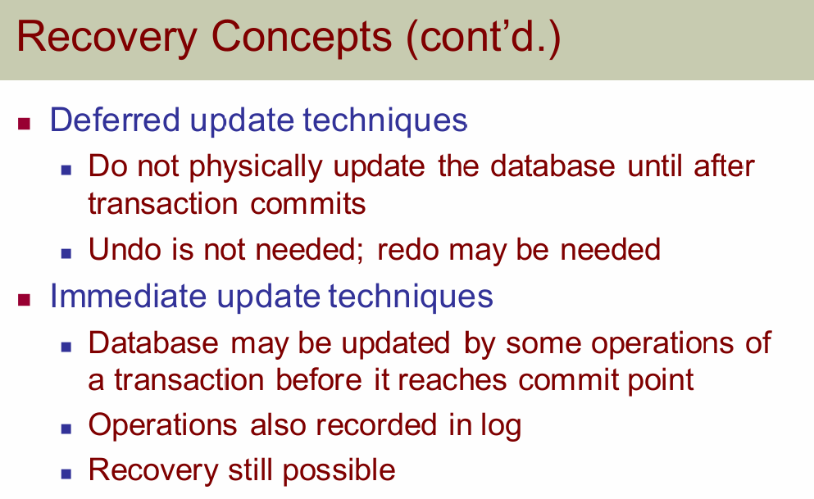

Slide 7
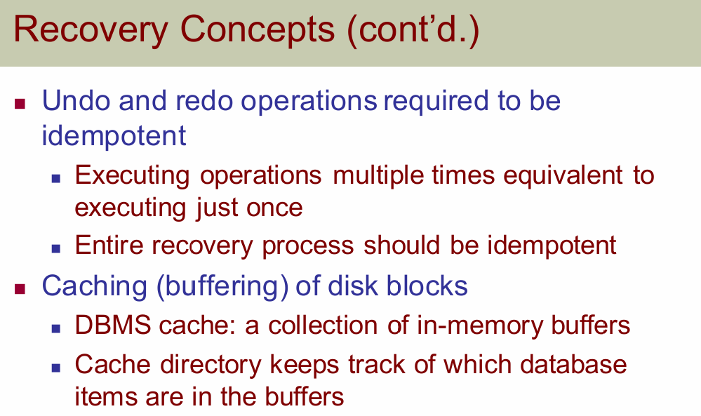

Slide 8
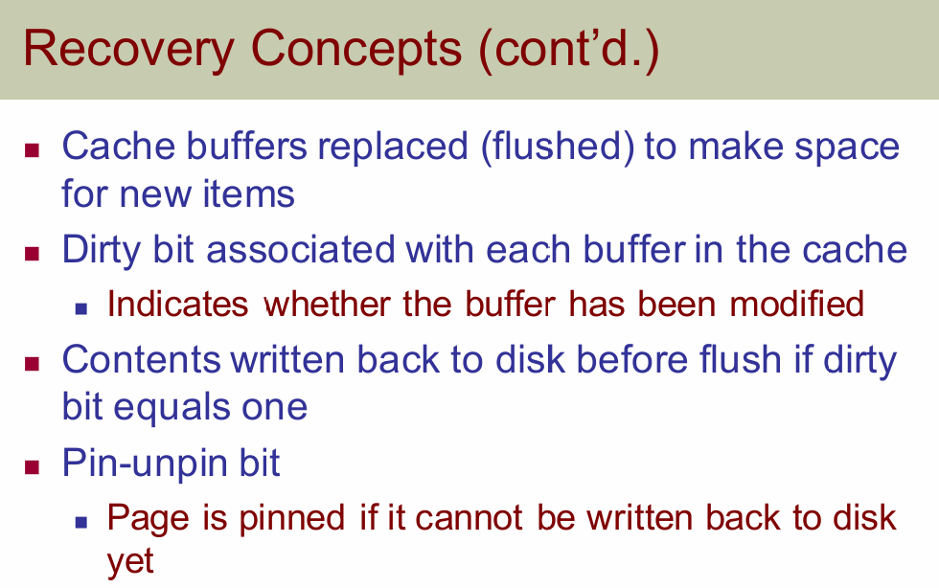

Slide 9
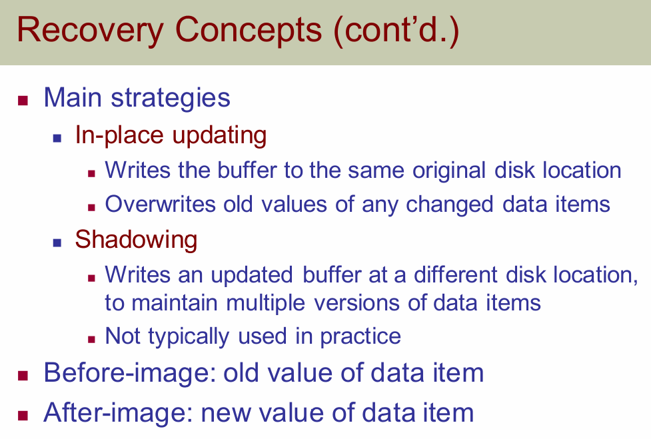

Slide 10
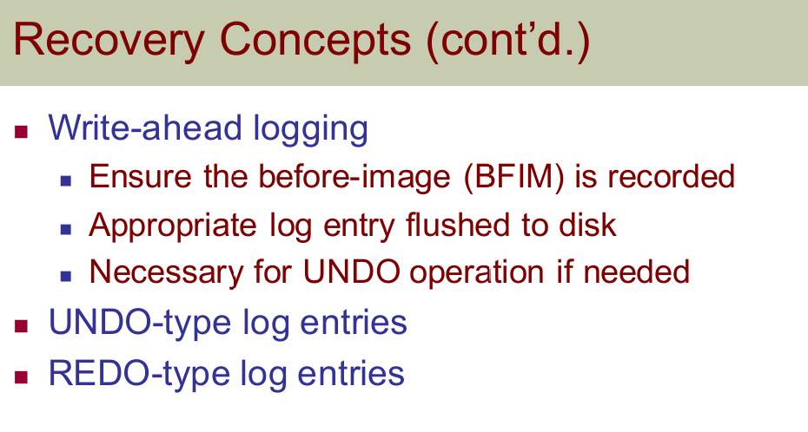

Slide 11
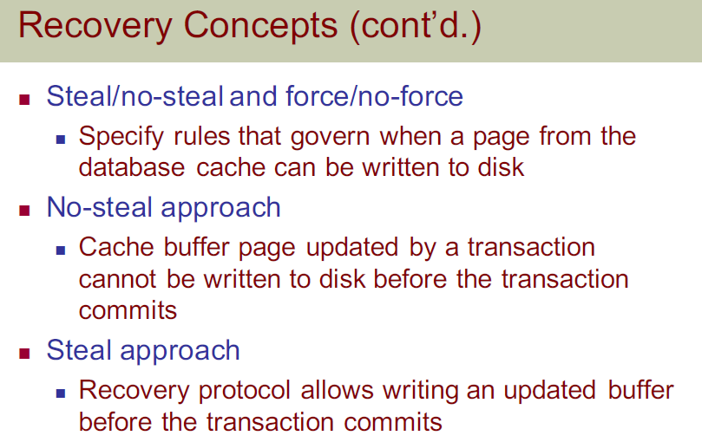

Slide 12
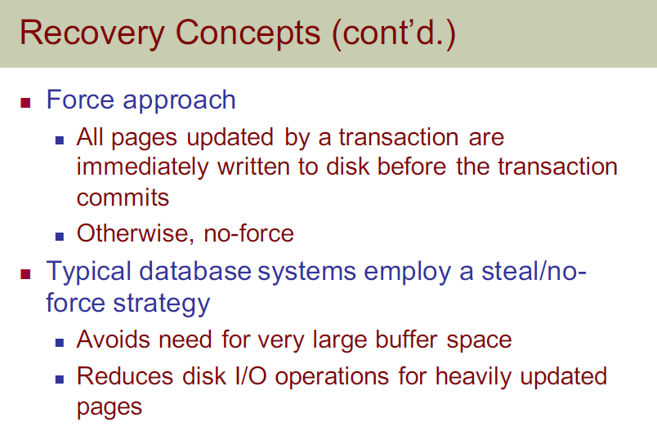

Slide 13
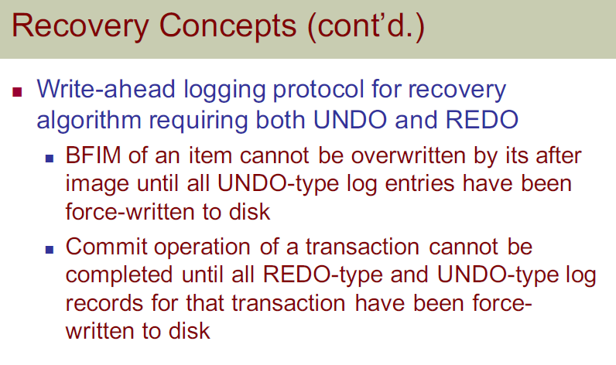

Slide 14
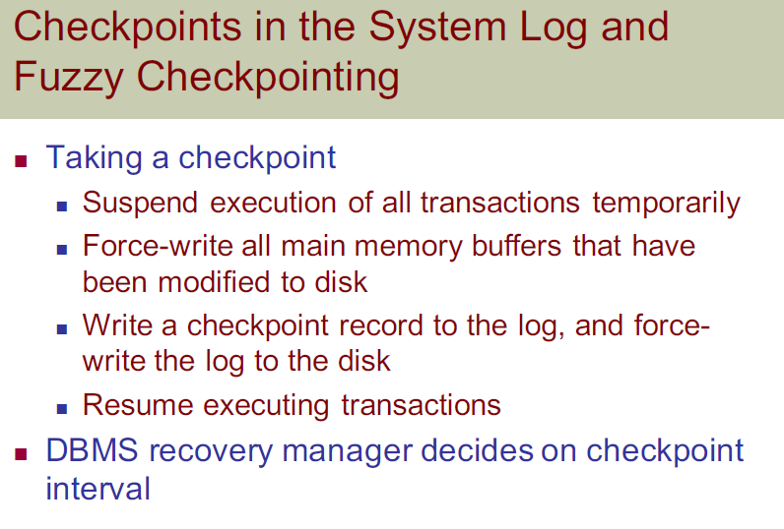

Slide 15
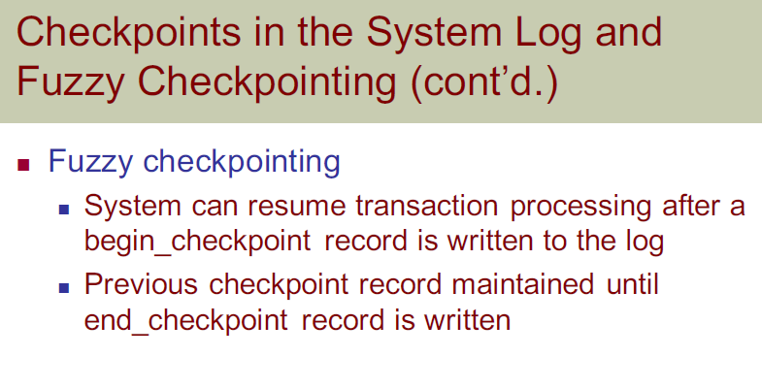

Slide 16
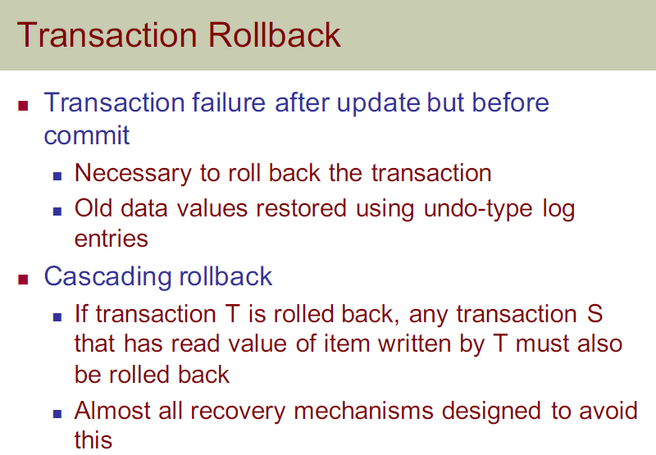

Slide 17
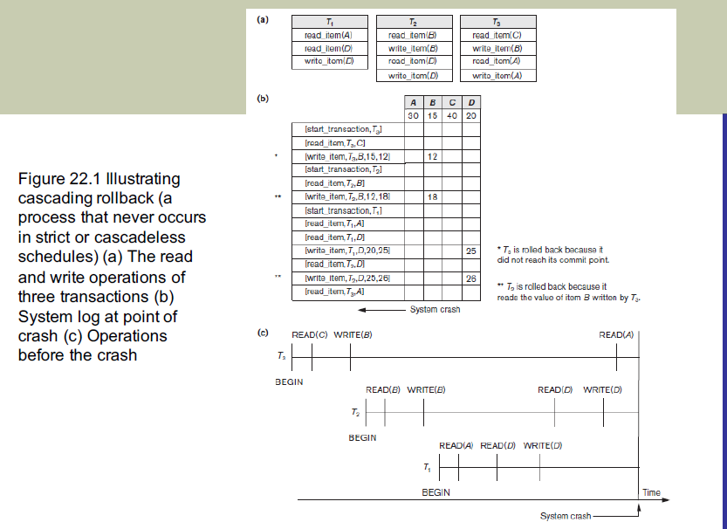

Slide 18
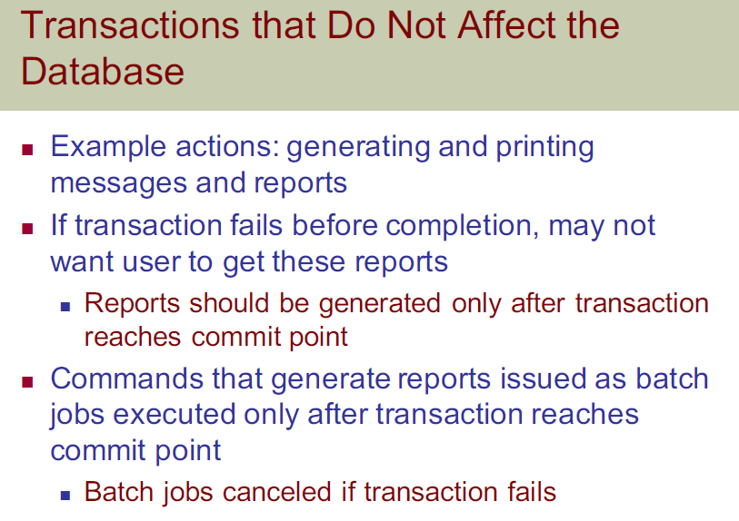

Slide 19
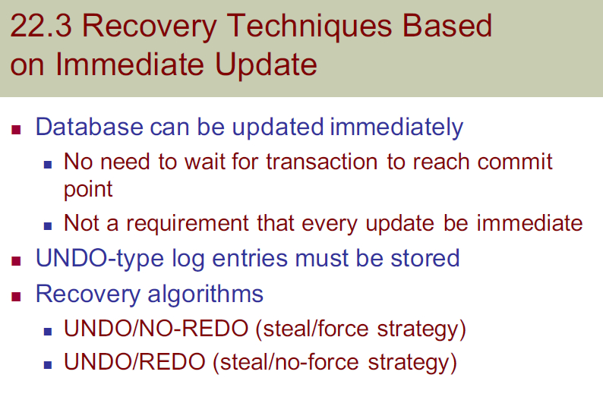

Slide 20
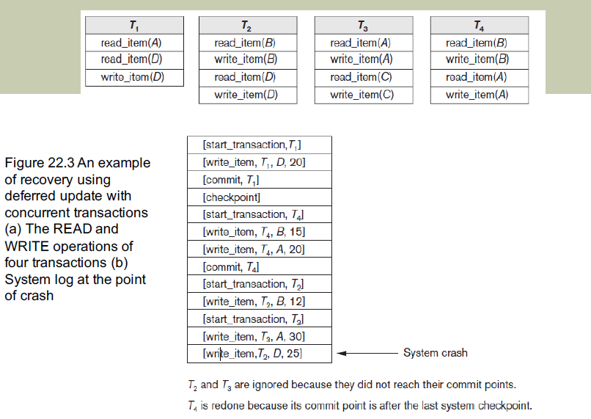

Slide 21
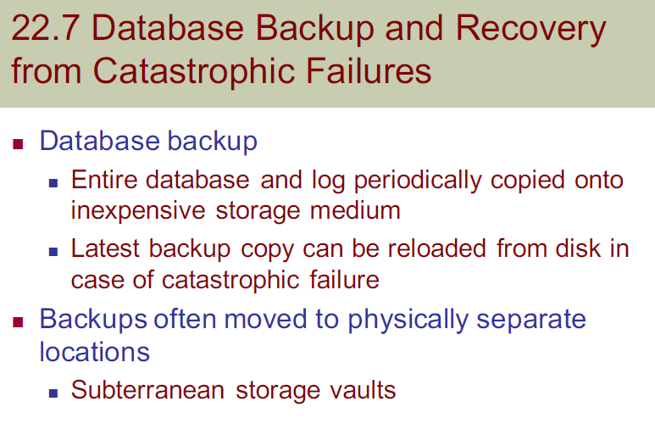

Slide 22
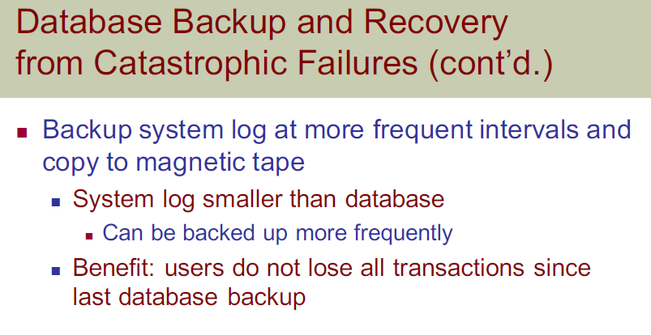

Slide 23
THANK YOU

